Slide 1

Supermarket Sales
Analysis

Slide 2


INTRODUCTION
This project is a study on dataset relating to sales data of a Supermarket based in Myanmar.
The Supermarket has three branch locations and six Product lines.
We have analyzed the dataset and presented with necessary suggestions to perform better and have a competitive advantage over rival supermarkets.
With the help of this project, we plan to achieve the following:
Analyze the dataset and provide necessary suggestions for better performance and increase sales.
Develop the best Classification Model.
Form Clusters with the help of Clustering Model.

Slide 3
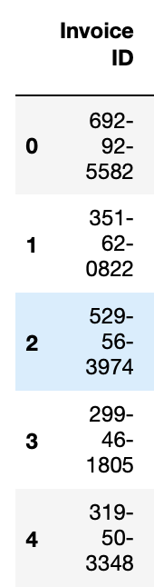
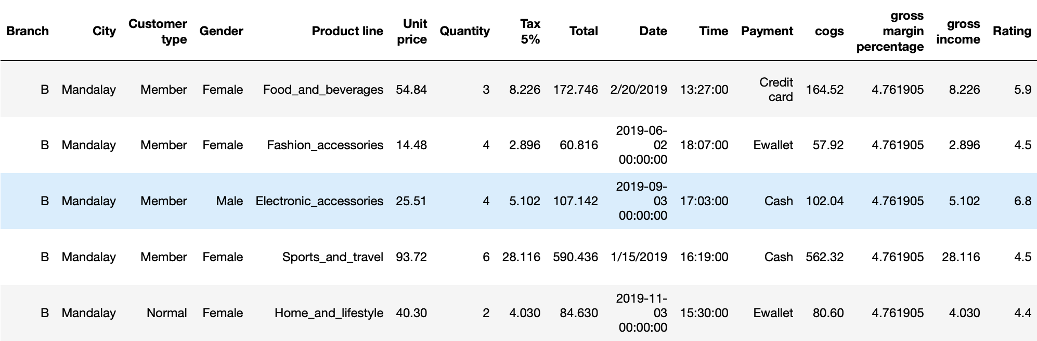
ABOUT DATASET
The dataset has been extracted from Kaggle. The link is as follows:
https://www.kaggle.com/datasets/rahuljangam/super-market-sales
The dataset has 1000 records with 17 variables.
Target Variable: Rating Input Variables: Other columns

Slide 4
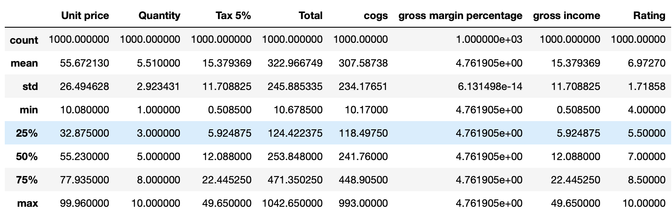
DESCRIPTIVE ANALYSIS
Below are the statistical summary of the numerical variables in the dataset.
Observations:
From the above table, we can see that the count of all the numerical variables is 1000, which means there are no missing values in the numerical variables.
The standard deviation of gross margin percentage is almost zero implying near zero variation.

Slide 5
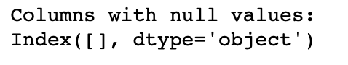
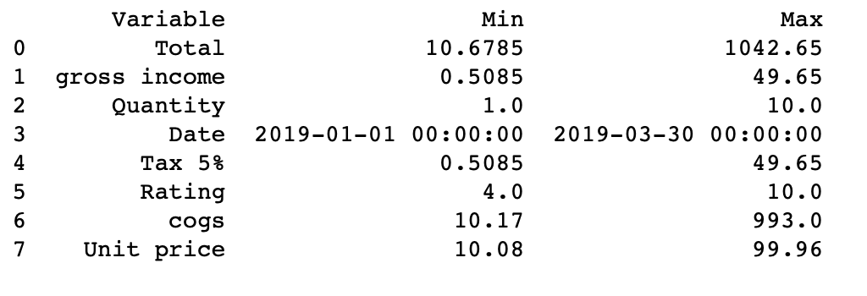
DESCRIPTIVE ANALYSIS
Are there any null values in the dataset?
NO
What are the Range for the Numerical Variables?

Slide 6
DATA PREPROCESSING
Dropping categorical variables with high cardinality and zero variance:
We found that Invoice ID has high cardinality and is not useful in our data analysis task. Hence, it was dropped from the dataset. There weren’t any categorical variables with zero variance.
Dropping numerical variable with zero variance:
We noticed that the ‘gross margin percentage’ has a near zero variance. Hence, dropped the variable since it would not be much useful in our data analysis task.
Editing ‘Date’ variable:
We observed that the ‘Date’ variable is differently formatted. Some are in mm/dd/yyyy format and some are in yyyy/mm/dd format. Hence, cleaning such variable to be of same format and adding a column ‘Weekday’ and ‘Hour’ columns for further analysis.

Slide 7
DATA PREPROCESSING
Dropping unwanted variables:
City: There are three cities in the dataset – Yangon, Mandalay and Naypyitaw. All three cities are categorized as Branch A, B and C respectively. Since, City and Branch are the same data, we are dropping ‘City’ variable and going ahead with Branch variable only.
Gross Income: The ‘Gross Income’ variable is a difference of ‘Total’ and ‘COGS’ variable. Hence, dropping it.
COGS: COGS (cost of goods sold) is a product of 'Quantity' and 'Unit Price'. Hence, it is dropped.
Tax5% : This variable was added in product of 'Quantity' and 'Unit Price' resulting in 'Total'. Hence, dropped it.

Slide 8
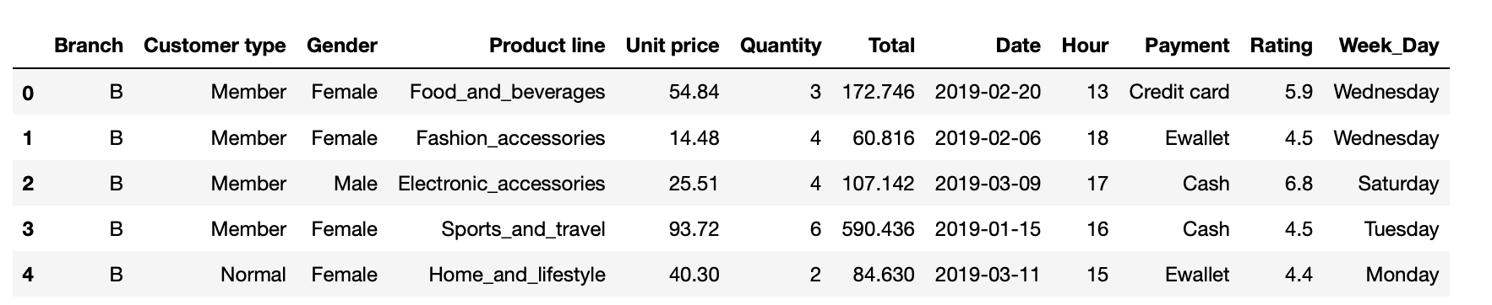
DATA PREPROCESSING
The dataset after complete Date Preprocessing is as follows:

Slide 9
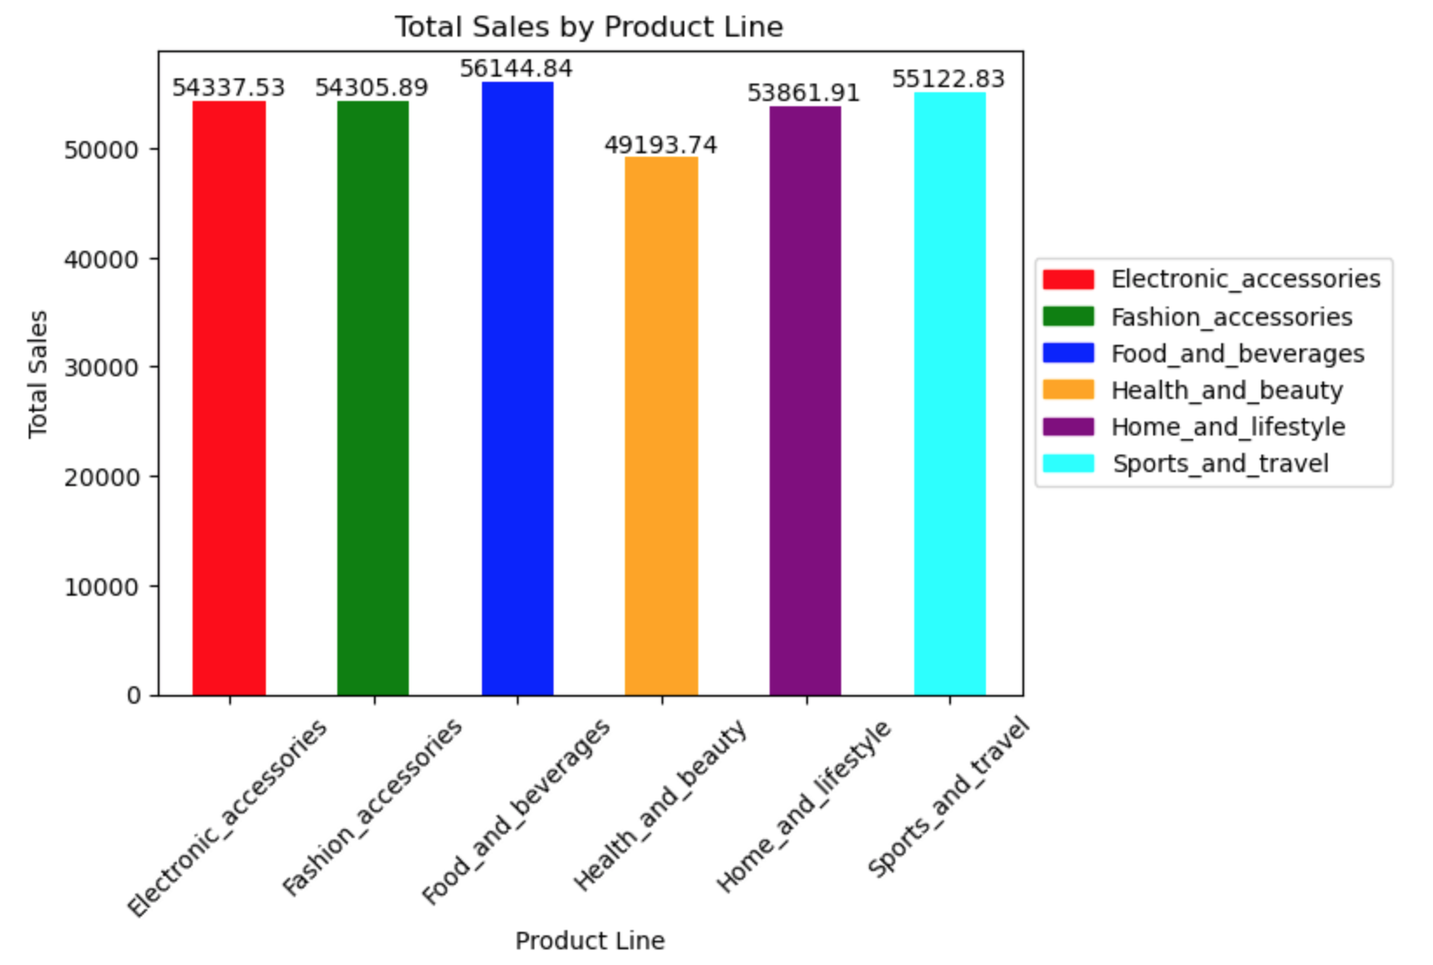
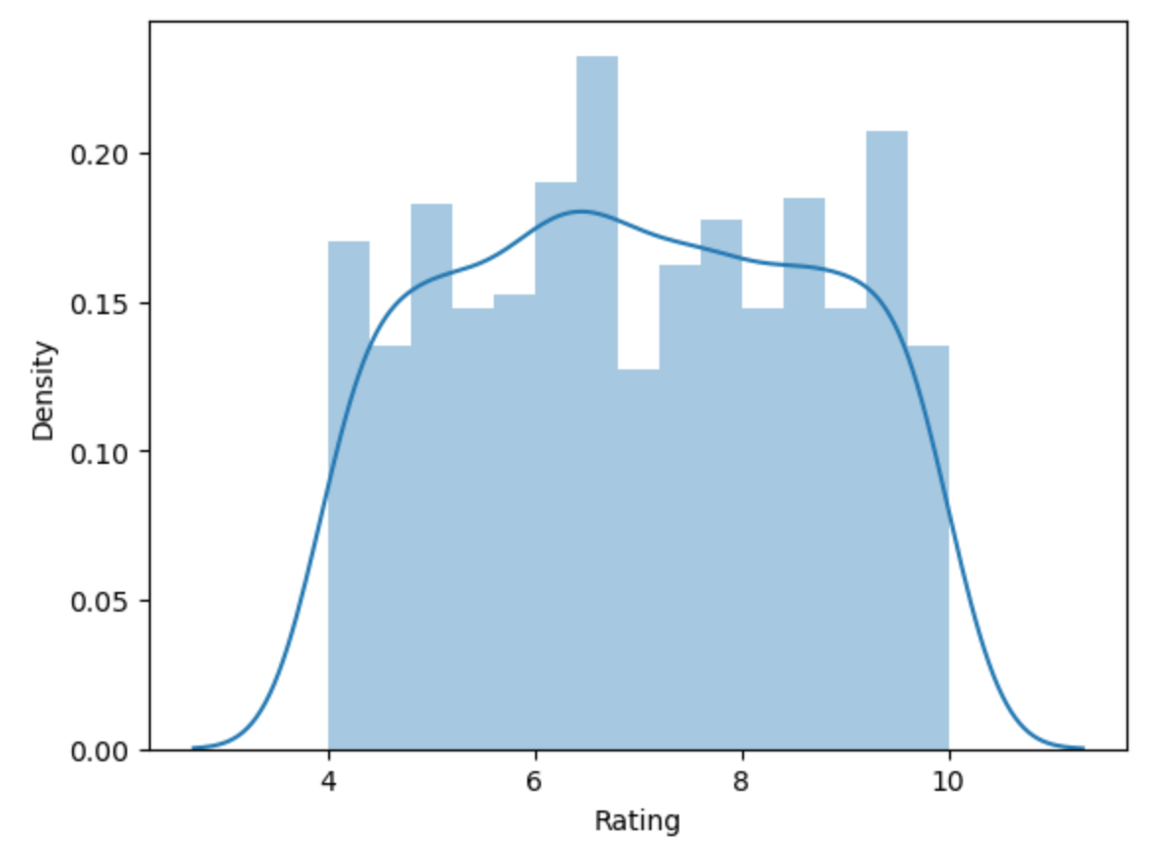
DATA VISUALIZATION
Total Sales by Product Line:
Food and beverages has the highest total sales with the value of 56,144 since it’s the basic need of people. Health and beauty has the least total sales with value of 49,193.
Histogram of Rating:
The histogram of Rating shows, 6-7 is the rating that is given by most of the customers for the products.

Slide 10
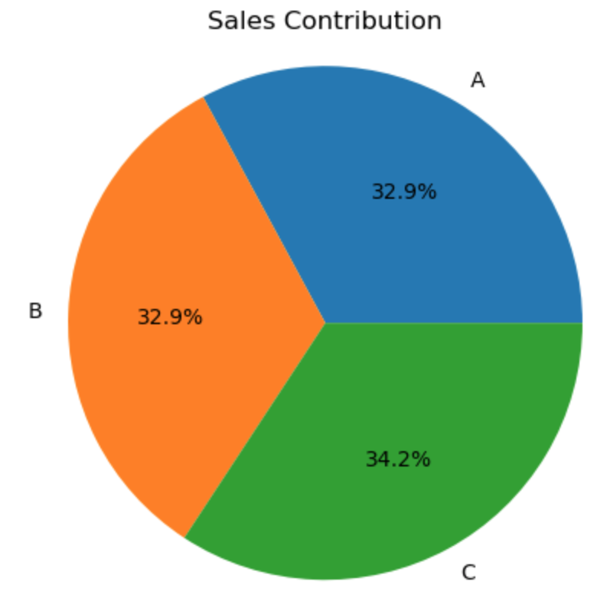
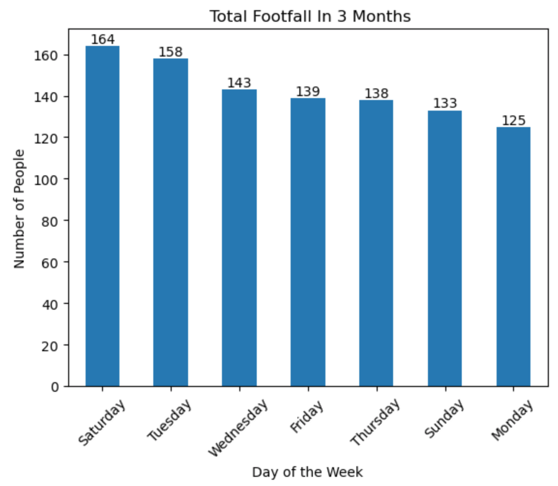
DATA VISUALIZATION
Total Footfall in 3 months:
Saturday has the maximum visits from customers, followed by Tuesday. Monday has the least visit. It seems that most of the customers prefer to shop on a holiday.
Sales Contribution by Branch:
Branch C has the maximum total sales with 34.2%. Branch A and B has equal total sales.

Slide 11
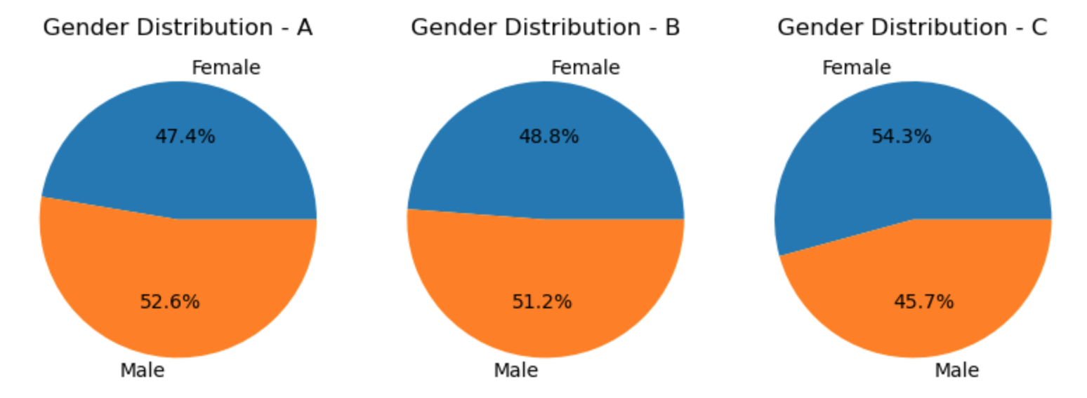
DATA VISUALIZATION
Ratio of Male and Female Customers in different Branches
From the above visualization, we can see that Branch ‘A’ and ‘B’ have more male customers compared to female customers.
However, in Branch ‘C’ we can see that it has more female customers compared to male customers.
One of the reasons might be the gender ratio of those locations. Hence, keeping in mind, the demography of respective branches, the supermarket can target their variety of products accordingly in order to increase the sales.

Slide 12
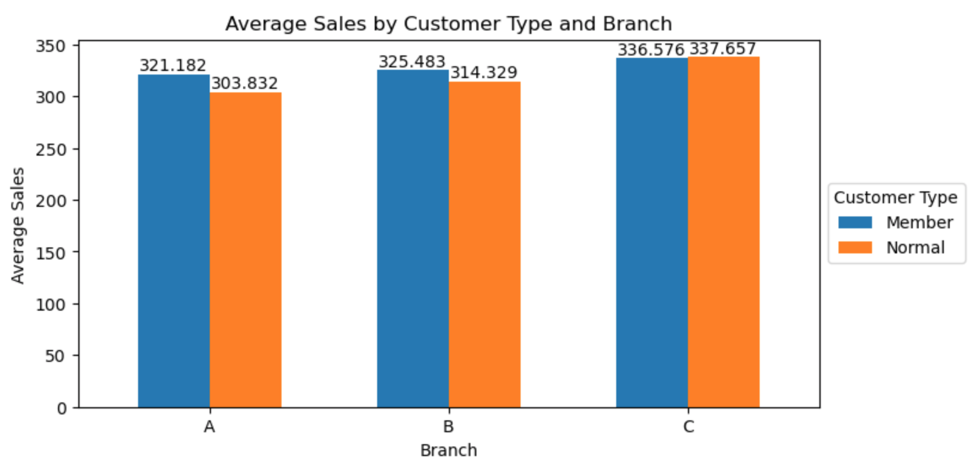
DATA VISUALIZATION
Average Sales By Customer Type and Branch
The visualization show that ‘Member’ customer type has the most average sales compared to ‘Normal’ customer type.
Branch C has got almost equal average sales from both member and normal customer type.
The supermarket can introduce new promotions in order to increase the membership of customers that can aid in increasing overall sales.

Slide 13
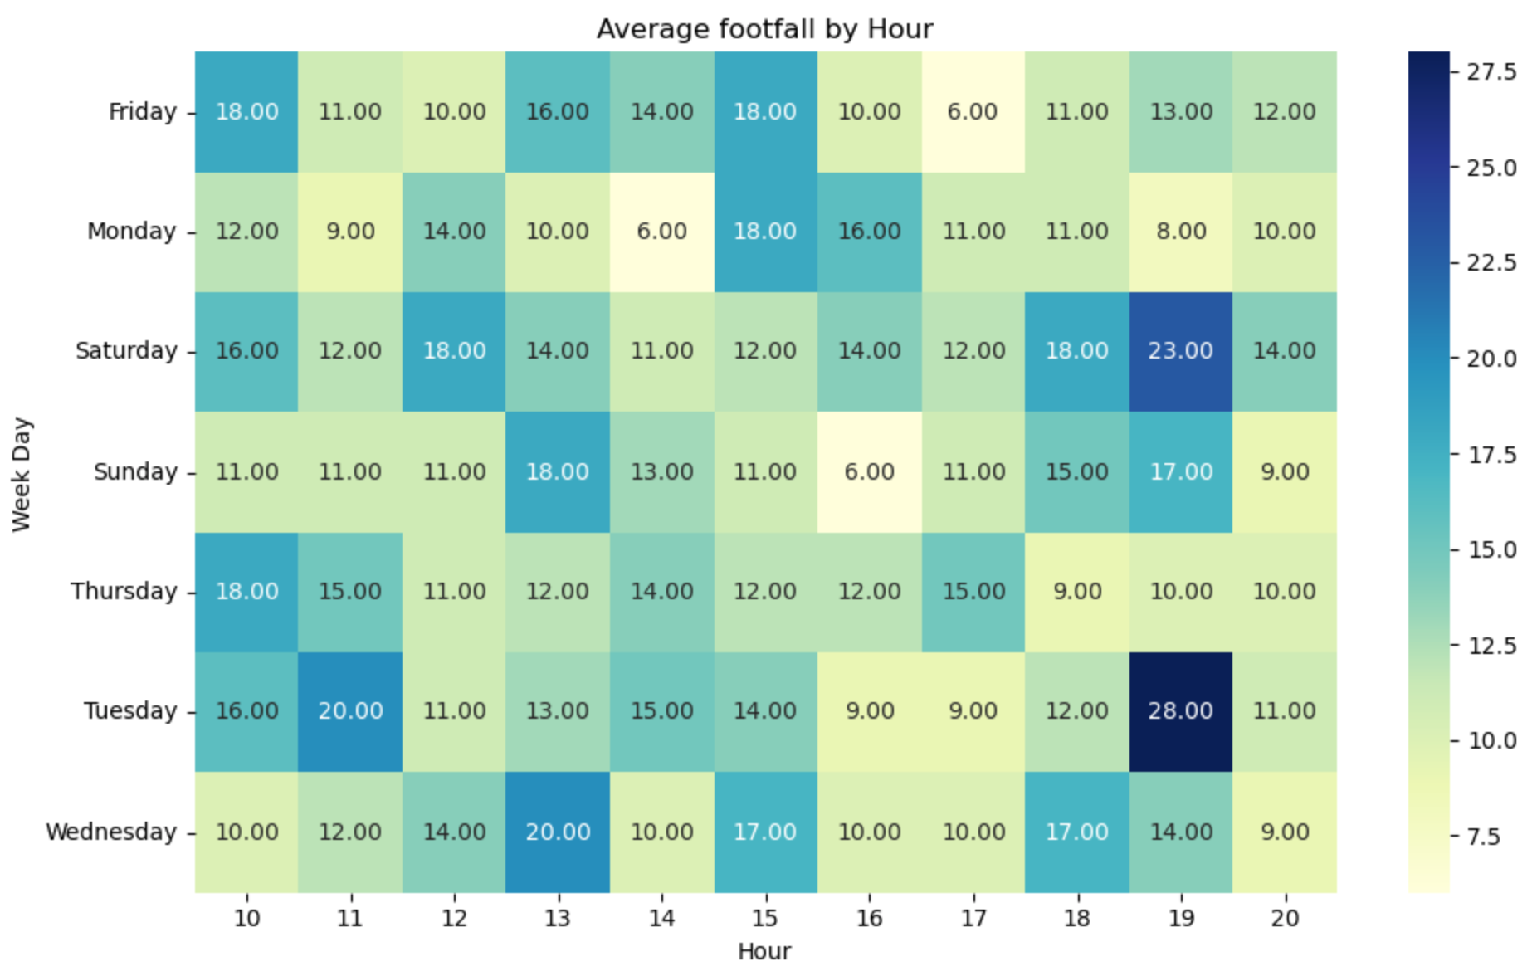
DATA VISUALIZATION
Average Footfall by Hour:
The corresponding visualization show that Saturday and Tuesday have the most average sales. Monday has the least average sales.
We can infer that customers prefer to shop on a holiday and hence, Saturday has the most sales.
Looking at hours, 11am-12pm, 3pm and 6-7pm is the time mostly visited by the customers to the supermarket.
The supermarket may have to increase its resources at such specific times and days to increase its efficiency.

Slide 14
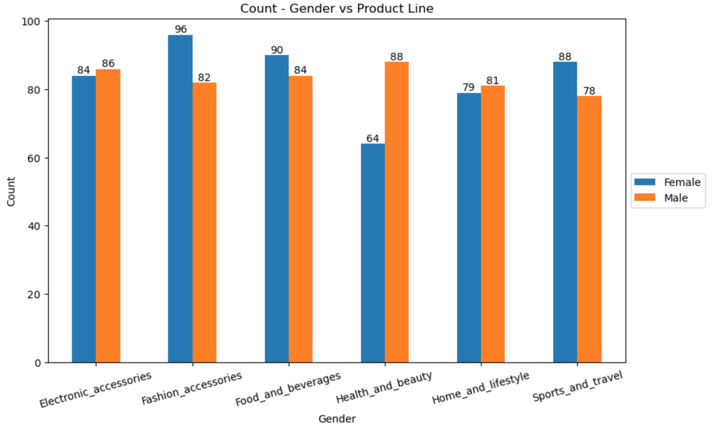
DATA VISUALIZATION
Count of sales by Gender and Product Line:
The corresponding visualization is a bar graph of sales count based on product line and gender.
Female customers are more interested in buying Fashion Accessories products and least interested in buying Health and Beauty products. This maybe Female customers in these cities are more interested in fashionable products rather than focusing on products for health and beauty.
On the contrary, Male customers are mostly interested in buying Health and Beauty products.
Sports and travel products are mostly bought by Females customers compared to male. This might be because females are mostly active in sports and travel in these cities.

Slide 15
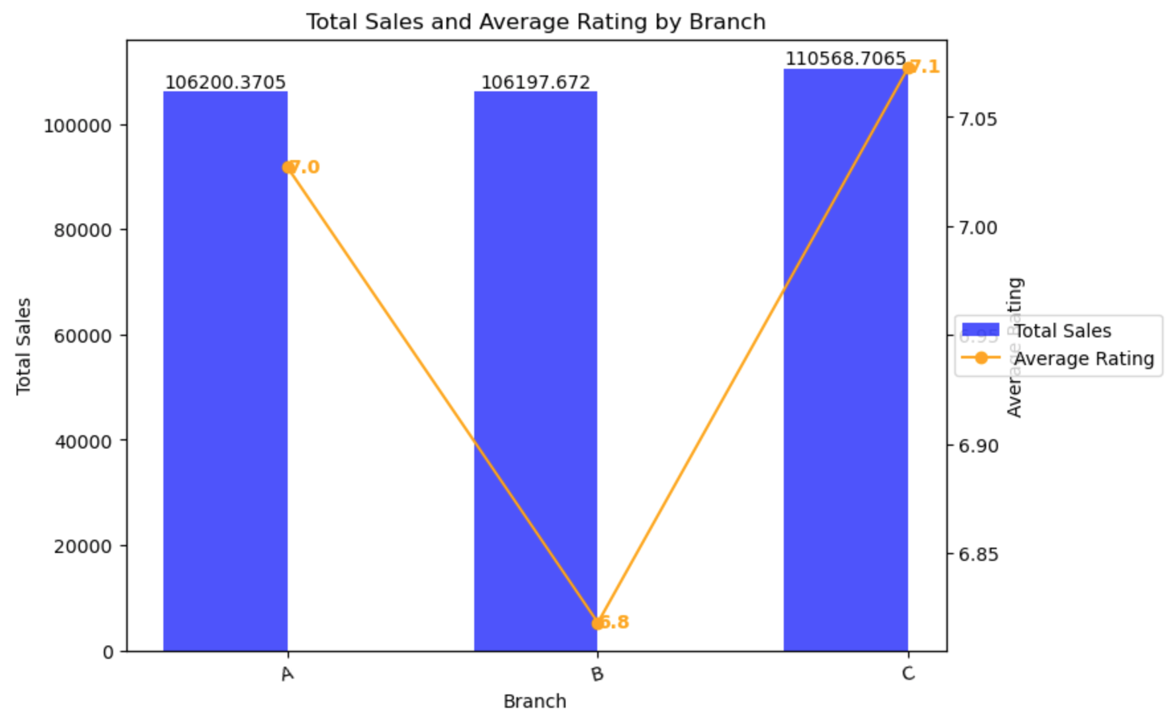
DATA VISUALIZATION
Total sales and Average Rating by Branch:
The corresponding bar graph is a figure of total sales by branch. Average rating is also plotted based on branch offices.
We can notice that Branch C has the highest average rating with 7.1 as well as highest sales.
Branch B has the lowest average rating of 6.8 as well as the lowest total sales.
We can infer that higher the sales figure, higher is the rating and lower the sales figure, lower is the rating.

Slide 16
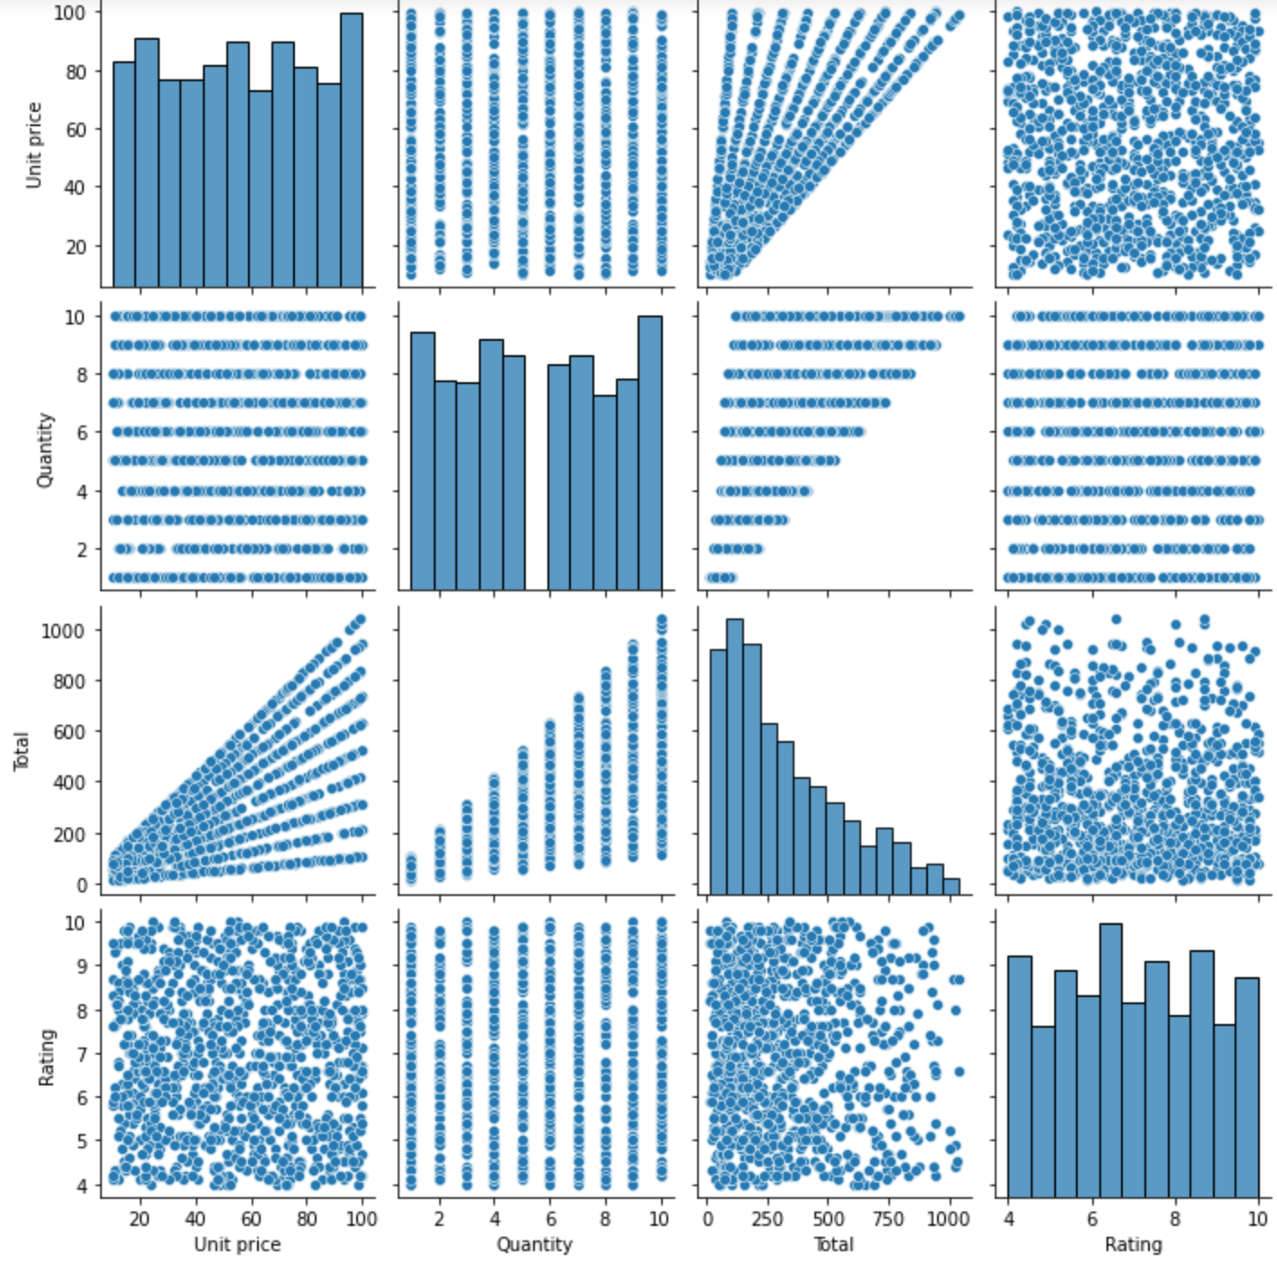
DATA VISUALIZATION
Scatterplot Matrix:
The corresponding is the scatterplot matrix of numerical variables.
Since, Total is a product of Quantity and Unit Price, it is obvious to have linear correlation among those variables.
The Scatter plot between Rating and other numerical variables is random. Hence, a good correlation cannot be developed.
Owing to these reasons, we have not considered Regression modeling.

Slide 17
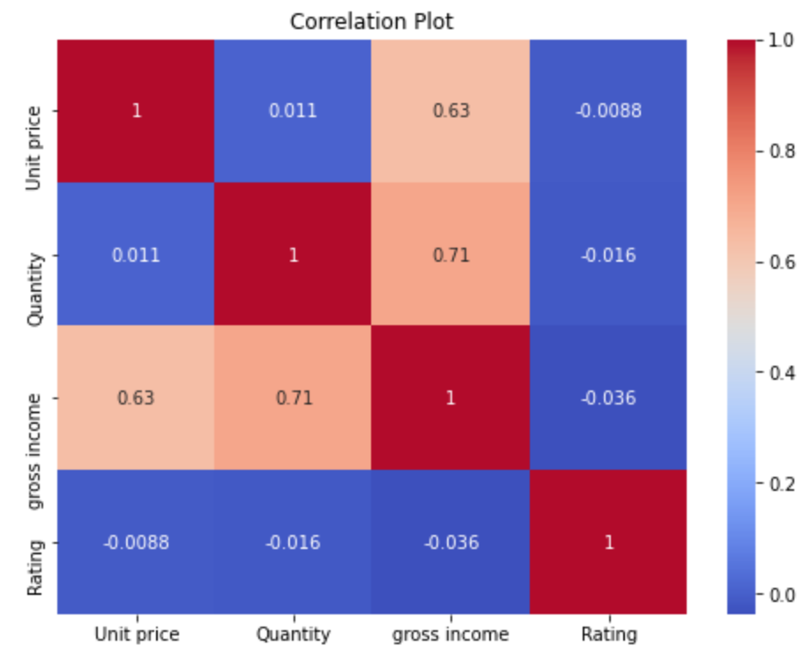
DATA VISUALIZATION
Correlation Matrix:
Gross income, quantity and unit price are the highly correlated variables.
The only reason being Gross Income is the product of unit price and quantity.
We could not notice high correlation between ratings and other variables.

Slide 18
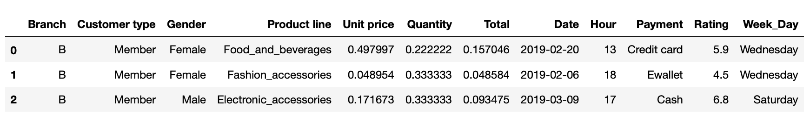
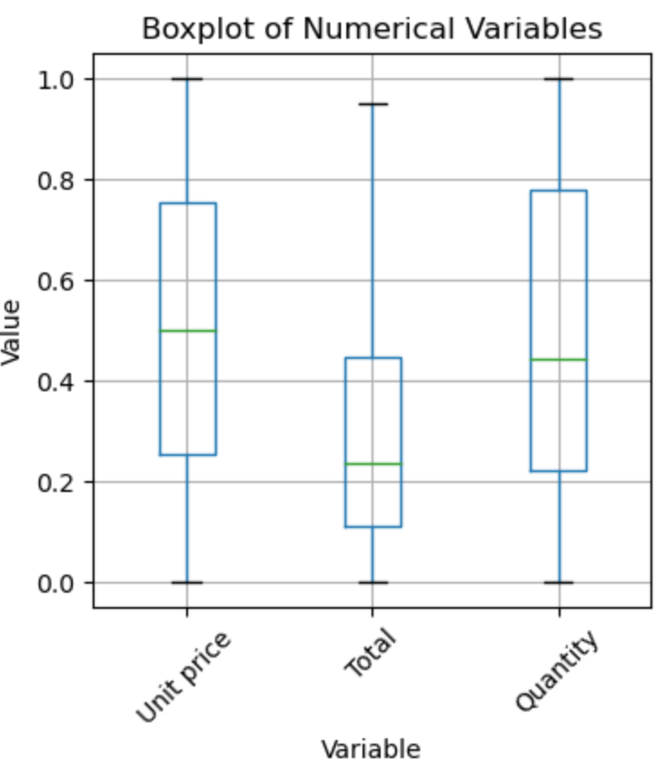
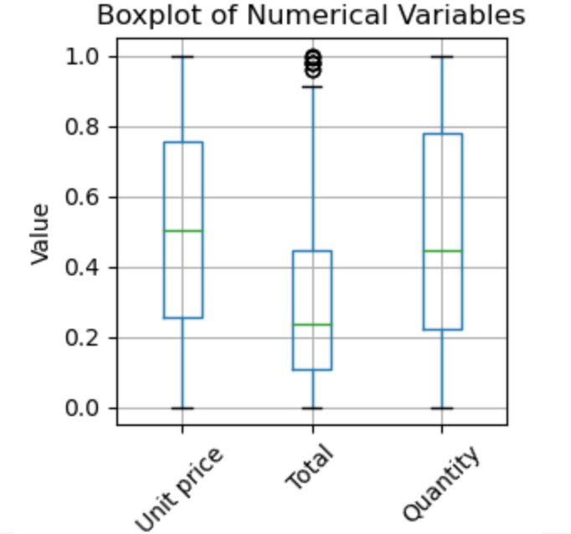
DATA PREPROCESSING FOR MODEL BUILDING
STEP 1: Scaling the numerical variables:
We scaled numerical variables – ‘Quantity’, ‘Total’ and ‘Unit Price’ in the range of 0 and 1.
The resulting dataset is as follows:
STEP 2: Imputing Outliners: ‘Total’ Variable has outliners which has been removed as follows:
Before:
After:

Slide 19
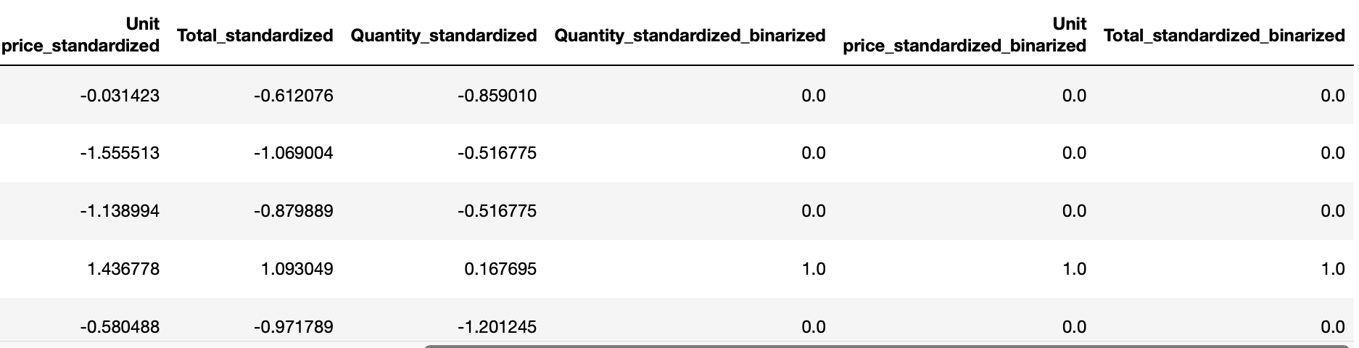
DATA PREPROCESSING
STEP 3: Standardizing and binarizing the numerical variables:
We standardized and then binarized the numerical variables.
The resulting dataset with the additional standardized and binarized numerical variables are as follows:

Slide 20
DATA PROCESSING
Step 4: Creating Dummy variables for Categorical Variables:
We created dummy variables for all of the categorical variables.
Step 5: Transforming Target Variable to Binary Variable:
We have chosen ‘Rating’ as the target variable. It ranges from 4-10. We have binarized the target variable into two groups:
0- low rating ( ratings less than or equal to 5) 1- high rating (ratings more than 5)
We have chosen Rating as the target variable since it is noticed that customers are influenced by higher ratings of products compared to lower ratings. Ratings help in boosting sales.
Step 6: Checking if the dataset is balanced and if not, balancing the dataset:
We checked if the dataset is balanced according to ‘Rating’ and it wasn’t. So, we balanced the dataset with each having 826 records as follows:

Slide 21
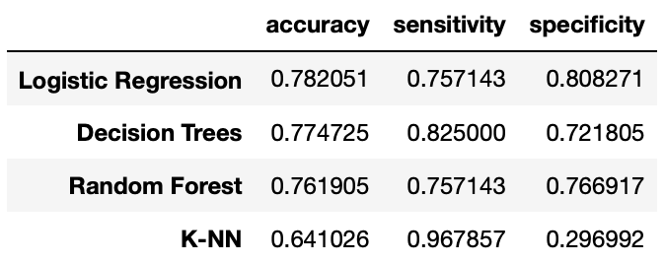
BUILDING CLASSIFICATION MODELS
The Classification Models that we built are as follows:
Logistic Regression
Decision Tree
Random Forest
KNN
The Confusion Matrix of the Classification Models are as follows:

Slide 22
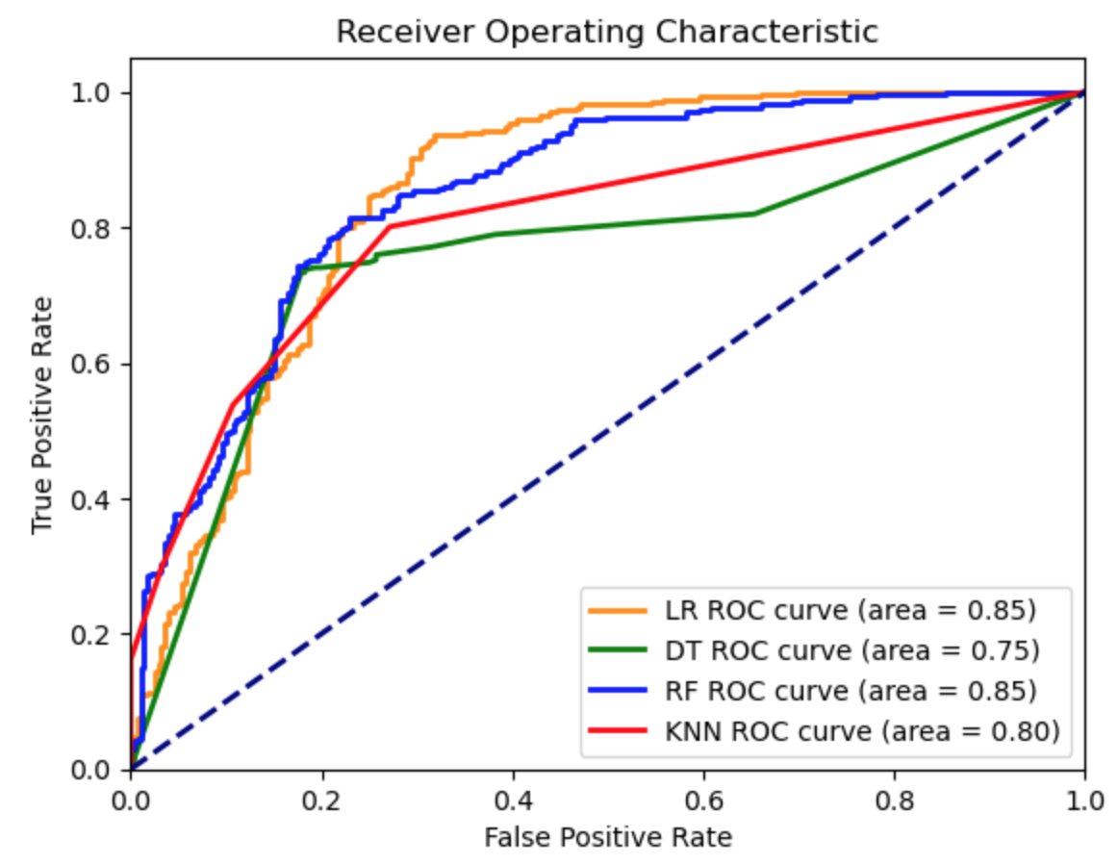
BUILDING CLASSIFICATION MODELS
Analysis of the Confusion Matrix and ROC Curve:
According to the Accuracy rate in Confusion Matrix, Logistic Regression is the best model.
The ROC Curve shows that both Logistic Regression and Random Forest has highest areas, hence are the best models.
We select Logistic Regression as the best model.

Slide 23
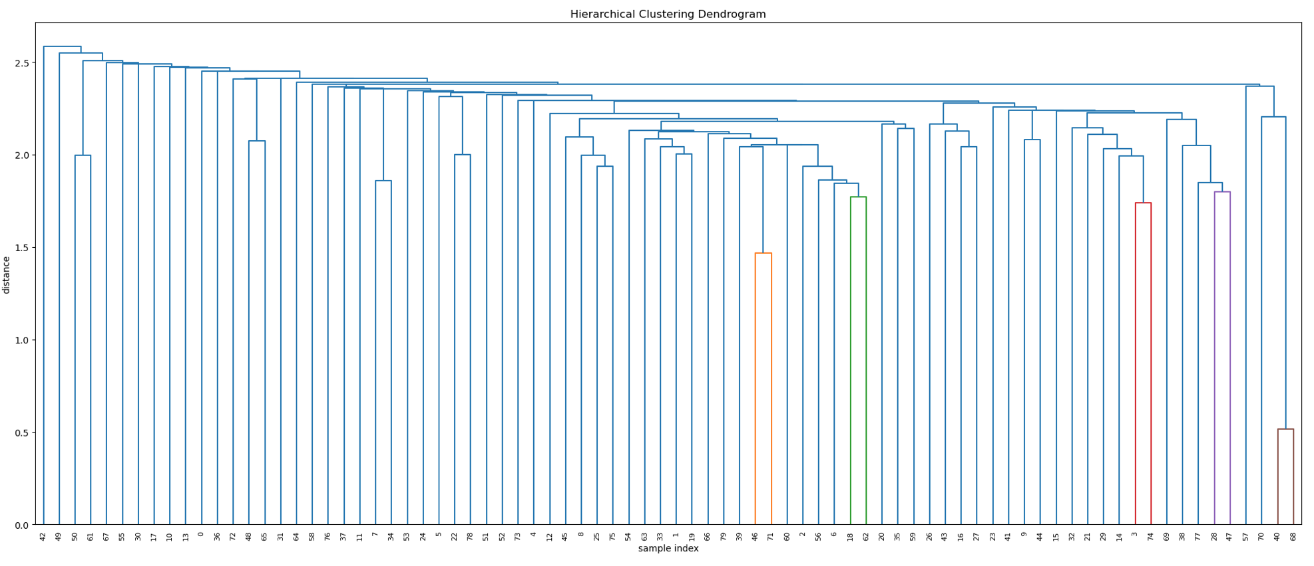
DEVELOPING CLUSTERING MODELS
Fitting Hierarchical Clustering and creating Hierarchical clustering Dendrogram:
No. of Clusters formed -2
Count in Each Cluster
Cluster Count
1 1651
2 1

Slide 24
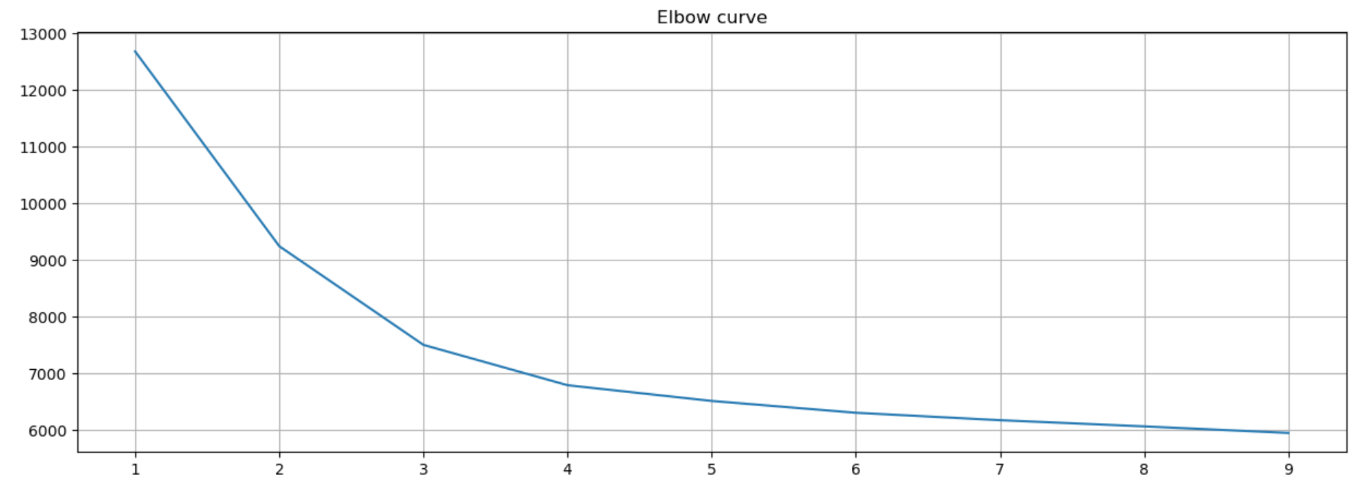
DEVELOPING CLUSTERING MODELS
Determining the number of cluster - KMeans Clustering:
The above elbow curve shows that the optimum number of clusters that can be developed are 6.
Notes:
After observing unsatisfactory results from the Hierarchical Model,
we decided to switch to the KMeans Clustering model.
To begin, we created an elbow curve by plotting distortion against the number of clusters.
We found that the graph's slope becomes nearly flat after 6 clusters, indicating that the optimal number of clusters is 6.
We then proceeded to run the KMeans model using our dataset with k as 6.
In the upcoming slides, I will walk you through our observations and conclusions.

Slide 25
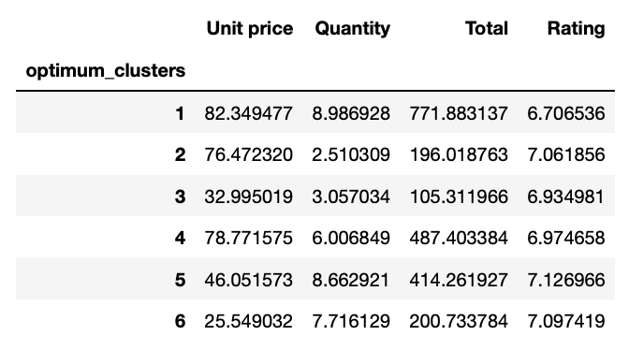
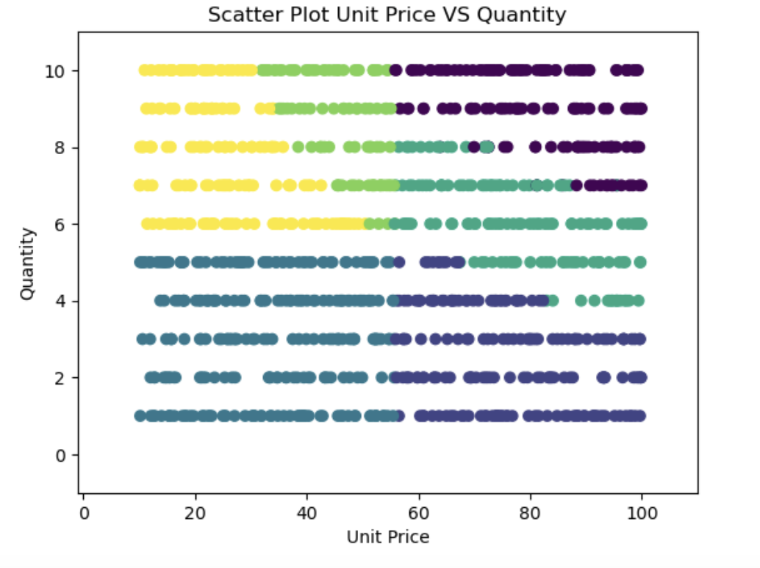
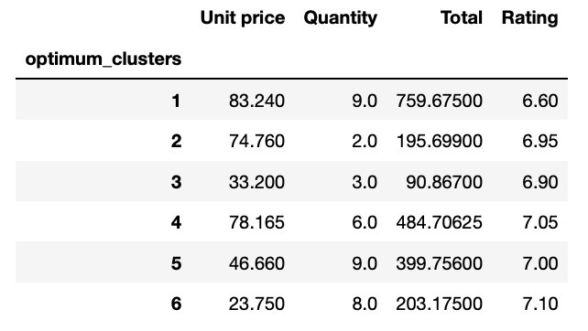
Analyzing Clusters
Mean Values
Median Values
Notes:
-After running the analysis, we assigned clusters to each data instance.
-Let's look at the tables on the right .
-The first table shows the average values of numerical variables grouped by clusters.
-The second table displays the median values of numerical variables grouped by clusters.
- Now let's focus on third cluster - Customers tend to purchase items with lower unit prices, quantity is low, and consequently total invoice value, having said that average rating is around 6.9.
-On the other hand, in cluster one, customers purchase items with higher unit prices and larger quantities, but average rating is on lower side, as low as 6.6-6.7
-In cluster six, customers buy items with lower unit price but higher in quantities. and has the best rating 7.1when compared to all other clusters.
-It is important for the supermarket to focus on customers from cluster one because any negative experiences for customer, may significantly impact sales and net income. Supermarket must think of more number of customer service hours to these customer.
-However, customers from other clusters are also important, and the supermarket must find ways to cater specific needs of those customers too.
-Like For customers in cluster three , the supermarket could consider implementing self-checkout kiosks to streamline the purchasing process for those buying low-priced items in small quantities, this helps in effectively using customer service team as well.
-This observation provides a very broad perspective, lets explore further details in the next slide.
-before getting into next slide, I want you to have a look at scatter plot here.
-lets see what color represents which cluster.

Slide 26
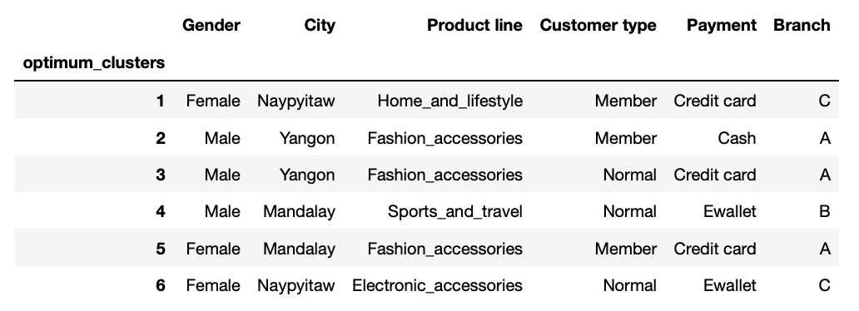
Analyzing Clusters
Frequent Category In Cluster - Mode
Notes:
In the previous slide we analyzed numerical variables, we shall further try to understand the nature of these clusters.
We analyzed the categorical variables by grouping them and determining the most frequent categories within each cluster.
This provided us with more detailed insights.
Customers in cluster one, are mostly female, and members, they mostly uses credit cards, and they mostly buy home and lifestyle products.
Branch A appeared in three clusters as most visited, and coincidently Fashion Accessories is the primary product category in all these clusters.
Branch C appeared in two clusters, with Electronic Accessories and home and lifestyle products are the top-selling items in these clusters.
It appears customers visiting Branch B buy sports and travel products more.

Slide 27
CONCLUSIONS
Food and beverage products are the mostly sold items, whereas health and beauty products are least sold. Supermarket needs to continue selling good quality food and beverage products to maintain its sales and can also focus on introducing new marketing strategies to sell more of health and beauty products.
Customers having membership are contributing more on supermarket’s sales. Hence, it can introduce new strategies to increase customer membership.
Saturdays and Tuesdays are the mostly shopped days with 11am, 3pm and 6-7pm being the busiest hours. The supermarket might need to increase its resources at those days and times to increase efficiency.
Most of the customers have given 6-7 ratings on a scale of 10 to their products. The supermarket must improve its customer service and product quality to increase its ratings to 9 and 10 to attract more customers. We developed 6 clusters from the Clustering Model. our analysis suggests that Branch A must be selling more of Fashion Accessories, Branch C Electronic Accessories and home and lifestyle products , and Branch B sports and travel goods. However, it is important to conduct a detailed study before making any business decisions based on these findings.
Management must focus on engaging with customers from clusters 1, 4 and 5 to improve customer experience, since these clusters are contributing significant sales cluster and work on reducing order processing time for customer visiting stores for smaller purchases.

Slide 28
LIMITATIONS
The data relates to sales of products ranging from Jan 2019 to March 2019 i.e. 3 months. We think additional data of at least more than a year’s sales record could give more insight on the sales of the supermarket.
The data could have included some other yes/no variables like if the product sold were advertised, if any customer service was provided while selling a product, feedback taken on products sold and so on, in order to make a better prediction of the ratings that are provided by the customers.
The Gross Margin Percentage variable in the dataset was uniform in all records (4.76%), which is practically not possible. Hence, the dataset require checking for accuracy.

Slide 29
THANK YOU

